Slide 1


Key management
Ms. Swati Mali
swatimali@somaiya.edu
Assistant Professor, Department of Computer Engineering
K. J. Somaiya College of Engineering
Somaiya Vidyavihar University

Slide 2
Key management
Why build a strong cryptanalysis machine when someone can be bribed with a cheaper and easier deal?
https://arstechnica.com/tech-policy/2014/08/john-walker-the-navy-spy-who-defined-crypto-betrayal-dead-at-77/
Ames, a 31-year CIA employee, and his wife, Rosario, were arrested Feb. 21 and charged with taking $1.5 million from the Soviets in exchange for classified information
https://library.cqpress.com/cqalmanac/document.php?id=cqal94-1102497

Slide 3
DiskLock program for Macintosh!!
DiskLock program for Macintosh (version 2.1), sold at most software stores, claimed the security of DES encryption.
It encrypts files using DES.
However, DiskLock stores the DES key with the encrypted file.
If you know where to look for the key, and want to read a file encrypted with DiskLock’s DES, recover the key from the encrypted file and then decrypt the file.
It doesn’t matter that this program uses DES encryption—the implementation is completely insecure.

Slide 4
Generating keys
The security of an algorithm rests in the key.
If you’re using a cryptographically weak process to generate keys, then the whole system is weak.
Eve need not cryptanalyze the encryption algorithm; she can cryptanalyze the key generation algorithm.

Slide 5
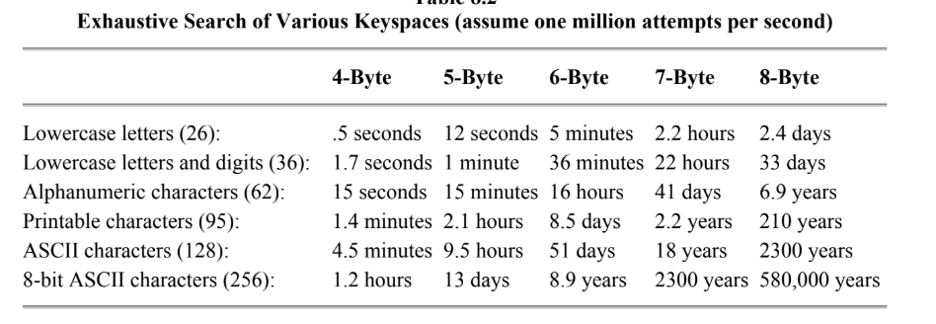
Generating keys
Keyspaces

Slide 6
Generating keys
Poor Key Choices
  dictionary attack
Random Keys
Pass Phrases
X9.17 Key Generation

Slide 7
What Is a Keyspace?
A keyspace is the set of all valid keys that an algorithm can use.
Example: If you use 128-bit keys, the keyspace has 2^128 possible keys.

Slide 8
What Makes a Keyspace Linear vs. Nonlinear
Linear Keyspace:
  If small changes in the key result in predictable or proportional changes in the output (ciphertext), the system is said to be linear.
  Often insecure, as it enables attacks like linear cryptanalysis.
Nonlinear Keyspace:
  The relationship between the key and the cryptographic output is non-predictable, even with small changes.
  Ensures that attackers cannot "interpolate" or guess keys using algebraic or statistical methods.

Slide 9
Nonlinear Keyspaces
All the keys are not equally strong.
Use an algorithm such that certain keys are stronger than others.
Avoid predictable key patterns to prevent attacks like brute force and dictionary attacks.
works if:
  the algorithm is secret and the enemy can’t reverse-engineer it,
  or if the difference in key strength is subtle enough that the enemy can’t figure it out.
The NSA did this with the secret algorithms in their Overtake modules

Slide 10
Nonlinear Keyspaces
A nonlinear keyspace ensures that keys do not produce outputs in a predictable or algebraically simple way, making the system robust against mathematical attacks.
It's a fundamental design principle in modern cryptography — not a specific algorithm, but a property essential for secure key generation and cryptographic strength.

Slide 11
Create non-linear keyspace Using Nonlinear Mathematical Structures
a) Elliptic Curve Groups
  Base cryptographic operations (like scalar multiplication) on elliptic curves over finite fields.
  The keyspace is the set of scalars k such that public key = k × G.
  This space is nonlinear due to the elliptic curve point addition rules.
  ✅ Used in: ECC (Elliptic Curve Cryptography), ECDSA, ECDH
b) Multivariate Polynomial Systems
  Use sets of nonlinear equations over finite fields.
  Public and private keys are generated via nonlinear mappings.
  ✅ Used in: Rainbow, HFE (Hidden Field Equations), other post-quantum schemes.
c) Lattices and Ideal Lattices
  Operations like rounding or closest vector problems in high-dimensional space behave nonlinearly.
  The key derivation process includes Gaussian sampling or trapdoor functions that resist linear modeling.
  ✅ Used in: NTRU, Kyber, FrodoKEM, etc.

Slide 12
Create non-linear keyspace :Apply Nonlinear Transformations in Key Schedules
a) Use of S-boxes
  S-boxes (substitution boxes) are nonlinear bijective functions used in block ciphers.
  Ensure the key material goes through S-boxes before being mixed into the encryption rounds.
  ✅ Used in: AES, DES, Serpent, Camellia
b) Bit Permutations and Modular Arithmetic
  Combining bit-level permutation with modular additions or multiplications introduces nonlinearity.
  Example: key[i] = (S_box[key[i]] + rotate(key[i-1], r)) mod 256

Slide 13
Where Are Nonlinear Keyspaces Used?
Symmetric Ciphers:
  AES: The S-box (substitution box) is highly nonlinear.
  Nonlinear mixing functions (e.g., in substitution–permutation networks) ensure the keyspace is complex.
Asymmetric Cryptography:
  Elliptic Curve Cryptography (ECC):
    Uses a nonlinear algebraic structure: elliptic curves over finite fields.
    Scalar multiplication on the curve is nonlinear.
Post-Quantum Cryptography:
  Many lattice- and multivariate polynomial-based schemes use nonlinear transformations in key generation to resist quantum attacks.

Slide 14
Transferring Keys
use a random-key generator at sender’s and receiver’s side
Use a trusted messenger
Use secure key exchange algorithms
  Deffie Hellman (?)
  ECDH
  QCDH
Out of band communication channel
Ring of trust
Digital certificate
Key distribution center
PGP
Secure communication channel
splits the key into several different parts and sends each of those parts over a different channel.

Slide 15
Verifying Keys
Use a shared key-encryption key which is known only to sender and reciever
use a digital signature protocol to sign the key, reciever has to trust the public-key database when he verifies that signature.
Key Distribution Center (KDC) signs sender’s public key

Slide 16
Verify Symmetric Keys
Symmetric keys (e.g., for AES) are shared secrets, so verification is more limited but still important.
✅ Common Practices:
Key fingerprints: Hash (e.g., SHA-256) of the key to verify integrity
MAC (Message Authentication Code) test:
  Encrypt & decrypt a known value using the key and verify the result.
Key Check Value (KCV): Encrypt a block of zeros and use that as a short checksum
Example:
AES key → encrypt 0x0000000000000000
Resulting ciphertext = KCV (Key Check Value)

Slide 17
Verify Asymmetric Keys (Public/Private Key Pairs)
Verifying that public and private keys form a valid cryptographic pair is essential.
Private Key ↔ Public Key Consistency
For RSA:
  Verify that encrypt(decrypt(data, d), e) == data
For ECC:
  Confirm public key = private_key × G (G is the base point)
For DSA/ECDSA:
  Sign a test message and verify with the public key
Certificate-Based Verification
In PKI (Public Key Infrastructure):
  Use a digital certificate signed by a Certificate Authority (CA)
  Verify with the CA's public key that the signature on the certificate is valid

Slide 18
Verify Key Fingerprints & Hashes
Public keys are often hashed (e.g., using SHA-256) to generate a fingerprint
These fingerprints can be compared:
  Out-of-band (e.g., phone call confirmation)
  Through UI prompts ("Does the displayed fingerprint match?")

Slide 19
Verify Chain of Trust Validation (PKI)
To verify public keys in secure communications (like HTTPS, email):
Check certificate signature
Verify certificate chain up to a trusted root CA
Check expiration, revocation status (via CRL or OCSP)
Match subject/common name to the domain or user
Example: TLS in a browser

Slide 20
Verify Secure Key Storage Verification
When keys are stored (e.g., in hardware or software keystores):
Validate key integrity using HMACs or hashes
Ensure correct decryption of encrypted key blobs using KDFs
Confirm no unauthorized access via secure audit logs

Slide 21
Using keys
Principle | Goal
Purpose limitation | Prevent misuse of keys
Access control | Ensure only authorized use
Strong encryption | Guarantee confidentiality
Auditing & logging | Enable traceability
Ephemeral key usage | Reduce exposure in memory

Slide 22
Using Keys
What if the encryption process is preempted over during its execution?
  Operating system might write the encryption application to disk, along with key.
  The key will sit on the disk, unencrypted, until the computer writes over that area of memory again.
  Could be exploited by some adversary
Solution: set the encryption operation to a high enough priority so it will not be interrupted.
Many encryption devices could be designed to erase the key if tampered with.
  For example, the IBM PS/2 encryption card has an epoxy unit containing the DES chip, battery, and memory.
Telephone encryptors use session keys and it is discarded after the use.

Slide 23
Using keys
1. Use Keys for Their Intended Purpose Only
Separation of Duties:
Use different keys for:
  Encryption vs. signing
  Data encryption vs. key encryption (DEK vs. KEK)
Prevents misuse or cryptographic vulnerabilities
2. Control Key Access
Restrict access using Access Control Lists (ACLs) or Role-Based Access Control (RBAC)
Integrate with Identity and Access Management (IAM) systems (e.g., AWS IAM, Azure AD)

Slide 24
Using keys
3. Always Use Authenticated Encryption
Use algorithms like AES-GCM or ChaCha20-Poly1305
Prevents both data leakage and tampering
4. Ensure Secure Key Usage in Code
Never hardcode keys in source code
Use secure APIs and key references from Hardware Security Modules (HSMs) or Key Management Services (KMSs)

Slide 25
Using keys
5. Use Keys with Proper Cryptographic Protocols
Use TLS (Transport Layer Security) when transmitting keys
Use hybrid encryption: RSA for key transport + AES for data
6. Audit and Monitor Key Usage
Log every key operation: encrypt, decrypt, sign, verify
Monitor for:
  Unexpected usage patterns
  Unauthorized access attempts

Slide 26
Using keys
8. Minimize Key Lifetime in Memory
Load keys only when needed
Zero out memory after use to prevent leakage through memory dumps
9. Ensure Compatibility and Interoperability
Keys may need to follow formats like PKCS#8, PEM, or DER
Important in multi-vendor or cloud-hybrid environments

Slide 27
Updating Keys
Why Update Keys?
Key aging: Over time, keys become vulnerable due to advances in computing or cryptanalysis.
Compromise: If a key is suspected to be exposed or misused.
Policy requirements: Security policies or regulations (e.g., PCI DSS, NIST) mandate periodic updates.
User/device rotation: When roles, devices, or users change.

Slide 28
How to update key?
1. Key Rotation
Replacing an old key with a new one while maintaining continuity.
Types:
  Manual rotation: Admin-initiated (e.g., reissuing API keys).
  Automatic rotation: Scheduled or policy-driven (common in cloud KMS).

Slide 29
Updating Keys
2. Forward Secrecy
Old communications cannot be decrypted even if a current key is compromised.
Achieved by frequent key updates or using ephemeral session keys (e.g., in TLS with Diffie-Hellman).

Slide 30
Updating Keys
4. Key Rotation Mechanisms
Dual key usage (during transition):
  Old key is used to decrypt
  New key is used to encrypt
Key wrapping:
  Encrypt new keys with a master Key Encryption Key (KEK)
Versioning:
  Track key versions (e.g., Key_v1, Key_v2) to manage lifecycle

Slide 31
Updating Keys
5. Re-encryption Strategy
When keys are updated, data encrypted with old keys may need to be:
  Re-encrypted with the new key
  Or decrypted on access, then re-encrypted on write
6. Key Derivation for Rotation
Derive fresh sub-keys regularly using Key Derivation Functions (KDFs):
  E.g., HKDF (HMAC-based Key Derivation Function)

Slide 32
Updating Keys
7. Logging and Auditing
Record when, why, and how keys are updated
Ensure audit trails for compliance (e.g., SOC 2, HIPAA)
8. Emergency Key Updates (Key Revocation)
If a key is compromised:
  Immediately revoke it
  Notify affected systems/users
  Initiate secure key replacement and data re-encryption

Slide 33
Updating Keys
9. Policy for Key Updates
Define update intervals (e.g., every 6–12 months)
Automate where possible
Document procedures and assign roles
10. Tools and Services
Use Key Management Systems (KMS) that support rotation:
  AWS KMS, Google Cloud KMS, Azure Key Vault
Use HSMs (Hardware Security Modules) for secure in-place updates

Slide 34
Updating Keys
Method | Purpose | Tools/Practices
Key Rotation | Regular update | KMS, versioning, dual usage
Key Revocation | Emergency response | CRL (Certificate Revocation List)
Re-encryption | Secure data migration | Background jobs, batch ops
Key Derivation | Subkey generation per use/session | HKDF, PBKDF2
Logging & Auditing | Compliance and traceability | SIEM, audit logs

Slide 35
Replace old cryptographic keys with new ones securely, with minimal disruption, while maintaining data confidentiality and integrity.

Slide 36
Key Updating Methods
1. Key Rotation
  Replacing keys at regular intervals or upon security events.
  Most common form of key updating.
How it works:
  Generate a new key.
  Re-encrypt new data (or all data, if needed) with the new key.
  Retire the old key (sometimes still kept to decrypt past data).
Used in:
  Symmetric systems (e.g., AES key rotation)
  TLS certificates
  API keys
2. Key Derivation Functions (KDFs) with New Salts
  Derive new keys from a master secret + new random salt.
  Provides key agility and supports key separation for different users/sessions.
Examples:
  plaintext
  CopyEdit
  new_key = HKDF(master_secret, new_salt)
  Used in TLS 1.3, SSH, and password-based encryption.

Slide 37
Key Updating Methods
3. Key Wrapping and Rekeying
  Instead of decrypting and re-encrypting all data, wrap the data key with a new master key.
✅ How it works:
  Data is encrypted with a data encryption key (DEK)
  DEK is encrypted (wrapped) with a key encryption key (KEK)
  To rotate KEK:
    Decrypt DEK with old KEK
    Re-encrypt DEK with new KEK
    No need to re-encrypt the data
Used in AWS KMS, Google Cloud KMS, HSMs
4. Forward Secrecy / Ephemeral Keys
  Frequently update keys per session or message.
  No long-term key reuse.
✅ Used in secure messaging (e.g., Signal Protocol), TLS 1.3

Slide 38
Key Updating Methods
5. Key Expiry and Auto-Renewal
  Keys are associated with expiration timestamps.
  Systems auto-generate and distribute new keys before expiry.
  Example:
  X.509 TLS certificates have a validity period (e.g., 90 days for Let’s Encrypt)
6. Key Update Protocols (KUPs)
  Specific protocols for securely updating keys between parties.
  Examples:
    IKEv2 Rekeying: In IPsec VPNs
    TLS Session Ticket Update
    Zigbee Key Update Procedure
7. Key Escrow and Re-encryption
  Old keys are archived in escrow.
  When updating keys, data is re-encrypted in bulk using new keys.
  Risky if not done securely – requires full access to plaintext.

Slide 39
When to Update Keys
Trigger Type | Examples
Time-based | Rotate keys every X days (e.g., every 90 days)
Security Event | Suspected breach or key compromise
Policy-based | Regulatory compliance (e.g., NIST mandates)
Usage-based | After N encryptions (as in AES-GCM nonce limits)
Personnel change | Key holder leaves the organization

Slide 40
Best Practices for key update strategy
Automate key rotation using secure KMS (AWS KMS, HashiCorp Vault)
Use versioning to track old and new keys
Audit all key updates and store logs securely
Ensure backward compatibility (e.g., for decrypting older data)
Avoid simultaneous rotation across multiple systems unless coordinated

Slide 41
Summary : Key Update Methods
Method | Description | Used In
Key Rotation | Regular replacement of keys | TLS, APIs, symmetric crypto
KDF with new salt | Derive fresh keys from master | TLS, password encryption
Key Wrapping | Rotate KEKs without touching encrypted data | HSMs, cloud KMS
Forward Secrecy | Per-session or per-message ephemeral keys | Signal, TLS 1.3
Expiry & Auto-Renewal | Timed expiry triggers rotation | Certificates, JWTs
Key Update Protocols | Secure rekeying messages | IKEv2, Zigbee, TLS

Slide 42
Storing Keys
Memorise the key(s) (!!!)
  Keys are longer, not very easy to remember
  Could turn out Single of failure
key in a magnetic stripe card, plastic key with an embedded ROM chip (called a ROM key), or smart card
inserting the physical token into a special reader in his encryption box or attached to the computer terminal.
Use key escrow technique
regenerate the keys from an easy-to-remember password every time they are required.
A key should never appear unencrypted outside the encryption device.

Slide 43
Key Storage Requirements
Property | Description
Confidentiality | Prevent unauthorized access to the key
Integrity | Ensure the key is not modified or corrupted
Availability | Ensure the key can be retrieved when needed by authorized systems/users
Auditability | Ensure every access, change, and operation on the key is logged and traceable

Slide 44
Key Storage Techniques
1. Hardware Security Module (HSM)
A physical device would securely generate, store, and use cryptographic keys.
Will Ensure that private keys never leave the secure hardware boundary.
Certified devices often comply with Federal Information Processing Standard (FIPS) 140-2 or 140-3.
Use Cases:
Root key storage
Payment systems
Digital certificates (Public Key Infrastructure)
Pros:
Physically tamper-resistant
High-performance cryptographic operations
Non-extractable keys
Cons:
Expensive
Requires physical and network integration

Slide 45
2. Trusted Platform Module (TPM)
A dedicated microcontroller integrated into computers
Stores cryptographic keys, digital signatures, and integrity measurements
Use Cases:
Full-disk encryption (e.g., BitLocker)
Platform attestation
Secure boot and identity keys

Slide 46
3. Key Management Service (KMS)
A cloud-based or on-premises service for centralized key storage and operations
Often backed by HSMs or software-based secure enclaves
Examples:
  Amazon Web Services Key Management Service (AWS KMS)
  Microsoft Azure Key Vault
  Google Cloud Key Management Service (GCP KMS)
Features:
  Access control using Identity and Access Management (IAM)
  Automatic key rotation
  Audit logs via CloudTrail, Azure Monitor, or similar

Slide 47
4. Operating System–Level Keystores
  Windows- Data-Protection API (DPAPI)
  macOS / iOS- Keychain
  Linux-GNOME Keyring, KWallet
  Android -Android Keystore System

Slide 48
5. Application-Level or Software-Based Keystores
Store encrypted keys within application configuration or files
Encrypt keys using a Key Encryption Key (KEK), often derived from user input via a Key Derivation Function (KDF) like PBKDF2, scrypt, or Argon2
Drawback: Security depends on how well the KEK is protected

Slide 49
6. Key Wrapping
Instead of storing a raw key directly, key wrapping means:
  Encrypting the target key with a Key Encryption Key (KEK)
  Storing the wrapped key instead
This technique enables:
  Layered protection
  Separation of data and key encryption
  Easier key rotation (re-wrap with new KEK)

Slide 50
Best Practices for Storing Keys
Practice | Description
Encrypt keys at rest | Always encrypt stored keys with a strong KEK or using HSM capabilities
Use non-exportable keys | Ensure keys can’t be exported from the storage module (if supported)
Use key hierarchy | Use a Data Encryption Key (DEK) for actual data, and a KEK to protect it
Enable auditing | Track key creation, access, rotation, and deletion
Validate integrity | Use Message Authentication Codes (MAC) or Hash-based Message Authentication Code (HMAC) to detect tampering
Rotate keys regularly | Reduce exposure in case a key is compromised

Slide 51
Common pitfalls to avoid
Pitfall | Risk
Storing plaintext keys | Immediate compromise if storage is accessed
Hardcoding keys in source code | Allows attackers to extract them from decompiled code
Weak KEKs | An encrypted key is only as strong as the KEK that protects it
No key rotation | Prolonged exposure to potential compromise
No access logs | Lack of audit trail impairs incident response

Slide 52
Backup Keys
key escrow
Split the key and store them with different people
store the split pieces, encrypted with each of the officer’s different public keys, on owner’s hard disk. That way, no one gets involved with key management until it becomes necessary.

Slide 53
Compromised Keys
If Alice’s key is lost, stolen or otherwise compromised, then all her security is gone.
If the compromised key was for a symmetric cryptosystem, Alice has to change her key and hope the actual damage was minimal.
If it was a private key, she has bigger problems
if a key-encryption key is compromised, the potential loss is extreme
a private key’s compromise must propagate quickly throughout the network.
Any databases of public keys must immediately be notified
Inform KDC if it’s involved in key distribution
Use Certificate revocation list- CRL

Slide 54
Compromised Key Response:
  Revoke and replace immediately.
  Notify affected parties.
  Check logs for unauthorized access.

Slide 55
Lifetime of Keys
No encryption key should be used for an indefinite period.
It should expire automatically like passports and licenses.
Key Lifetime Considerations:
  Shorter key lifetimes reduce exposure to attacks.
  Use key expiration policies for automated rotation.
Reasons-
  The longer a key is used, the greater the chance that it will be compromised.
  The longer a key is used, the greater the loss if the key is compromised.
  The longer a key is used, the greater the temptation for someone to spend the effort necessary to break it
  It is generally easier to do cryptanalysis with more ciphertext encrypted with the same key.

Slide 56
Lifetime of Keys
Session keys – last only for a session
Key-encryption keys don’t have to be replaced as frequently.
balance the inherent danger in keeping a key around for a while with the inherent danger in distributing a new one.
Encryption keys used to encrypt data files for storage cannot be changed often, as The files may sit encrypted on disk for months or years

Slide 57
Lifetime of Keys
Private keys used for digital signatures and proofs of identity may have to last years (even a lifetime).
Private keys used for coin-flipping protocols can be discarded immediately after the protocol is completed.
Even if a key’s security is expected to last a lifetime, it may be prudent to change the key every couple of years. T
he private keys in many networks are good only for two years; after that the user must get a new private key.
The old key would still have to remain secret, in case the user needed to verify a signature from that period.
But the new key would be used to sign new documents, reducing the number of signed documents a cryptanalyst would have for an attack.

Slide 58
Destroying Keys
Given that keys must be replaced regularly, old keys must be destroyed.
Old keys are valuable, even if they are never used again.
If the key is written on paper, the paper should be shredded or burned
If the key is in a hardware EEPROM, the key should be overwritten multiple times.
If the key is in a hardware EPROM or PROM, the chip should be smashed into tiny bits and scattered to the four winds.
If the key is stored on a computer disk, the actual bits of the storage should be overwritten multiple times or the disk should be shredded.

Slide 59
Destroying Keys
Key Destruction:
  Use secure wiping tools (e.g., overwrite with random data).
  Physically destroy hardware storing sensitive keys.
Public-Key Key Management:
  Use Certificate Authorities (CAs) to issue and revoke public keys.
  Implement Public Key Infrastructure (PKI) for secure identity management.

Slide 60
Key Exchange Algorithm :
Diffie-Hellman Key Exchange Algorithm

Slide 61
Diffie-Hellman Key Exchange
The Diffie-Hellman Key Exchange (DHKE) allows two parties to securely establish a shared secret key over an insecure channel.
This shared key can then be used for encryption and decryption of messages.
Invented in 1976
relies on the mathematical properties of modular exponentiation and discrete logarithms, which are computationally hard to reverse.

Slide 62


Whitfield Diffie & Martin Hellman

Slide 63
Primitive root(generator)
Every prime number has a primitive root
A primitive root of a prime number p is an integer g such that its powers generate all the coprime numbers from 1 to p−1 modulo p.
That is, for every integer a such that 1≤a<p, there exists some exponent k such that:
g^{k} ≡a mod p

Slide 64
A primitive root g modulo n, where n is a positive integer, is a number whose powers generate all the integers relatively prime to n.
For example, 2 is a primitive root modulo 5
  2^1 mod 5 = 2
  2^2 mod 5 = 4,
  2^3 mod 5 = 3,
  2^4 mod 5 = 1
  all the numbers relatively prime to 5 (which are 1, 2, 3, and 4).

Slide 65
  3 is a primitive root modulo 7
    3^1 mod 7 = 3,
    3^2 mod 7 = 2,
    3^3 mod 7 = 6,
    3^4 mod 7 = 4,
    3^5 mod 7 = 5,
    3^6 mod 7 = 1
    i.e. it generates all the numbers relatively prime to 7 (1, 2, 3, 4, 5, and 6)

Slide 66
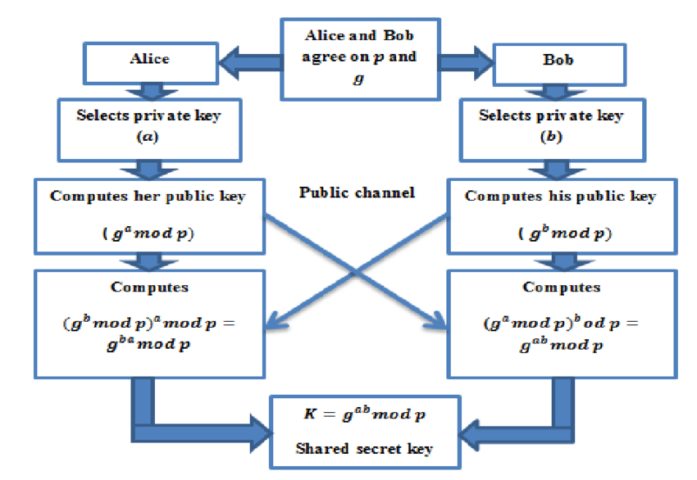
D-H Algorithm

Slide 67
Let’s assume:
p=23, g=5
Alice picks a=6, Bob picks b=15
Compute Public Keys
Alice computes
A=5⁶ mod 23 =15625 mod 23 =8
Bob computes
B=5¹⁵mod 23= 30517578125 mod 23 =19
Compute Shared Key
Alice computes S=19⁶mod 23= 47045881 mod 23=2
Bob computes S=8¹⁵mod 23 = 35184372088832vmod 23=2
Both end up with the same shared secret key S=2 which can now be used for encryption-decryption process

Slide 68
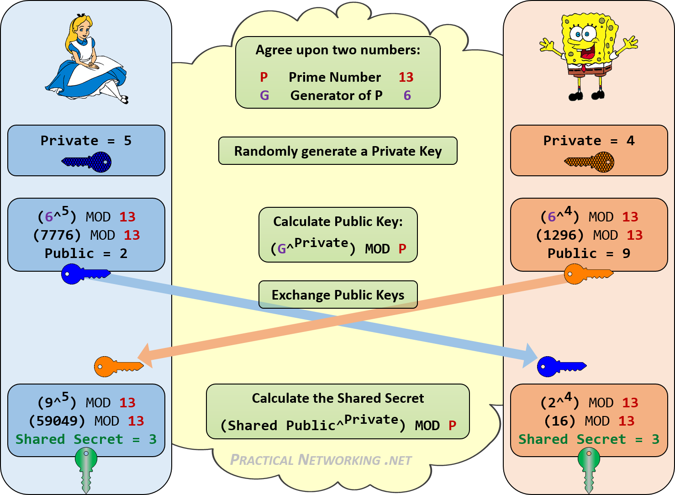

Slide 69
Security of Diffie-Hellman
The security is based on the difficulty of solving the Discrete Logarithm Problem (DLP).
Given A=gª mod p, finding a (the private key) is computationally hard when p is large.
However, Diffie-Hellman is vulnerable to Man-in-the-Middle (MITM) attacks,
  MITM-where an attacker intercepts and replaces public keys.

Slide 70
Improvements over D-H
Elliptic Curve Diffie-Hellman (ECDH)
Quantum cryptography Diffie-Hellman (QCDH)
Digital Signatures

Slide 71
Applications of Diffie-Hellman
Secure Web Browsing (HTTPS/TLS for establishing secure communication between a browser and a server.
VPNs & Secure Messaging: Used in IPsec VPNs and encrypted chat applications like Signal and WhatsApp.
Blockchain & Cryptocurrencies: Secure peer-to-peer transactions.

Slide 72
Questions?

